Slide 2
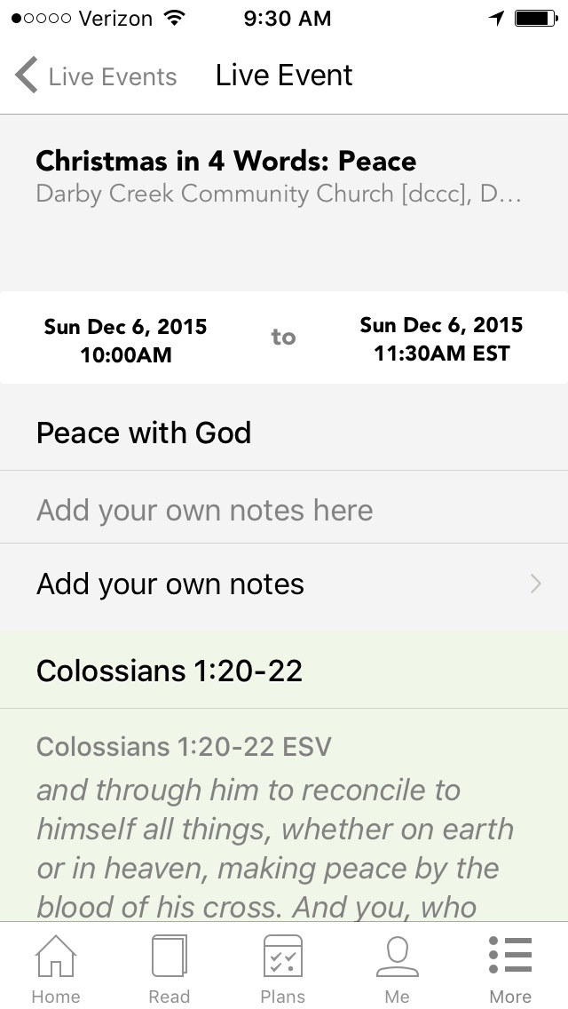

Slide 3
Two Kinds of Peace
Peace – Christmas in 4 Words

Slide 4
Peace with God
Colossians 1:20-22; Romans 5:1
Jesus’ birth, death, and resurrection made peace with God possible.
Peace – Christmas in 4 Words

Slide 5
The Peace of God
John 14:27; Philippians 4:6-7
Once we have a relationship with God through Jesus, we can experience peace in this life regardless of circumstances.
Peace – Christmas in 4 Words

Slide 6
God Promises His Peace and Presence when We Trust Him
Judges 6: 24; Matthew 8:23-27; Proverbs 3:5-7
Peace – Christmas in 4 Words

Slide 7
